Slide 1


Serverless Computing:
Customer Adoption
Insights & Patterns
Michael Behrendt
IBM Distinguished Engineer Chief Architect, Serverless/FaaS & IBM Cloud Functions
@Michael_beh
© 2017 IBM Corporation

Slide 2


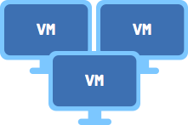

Evolution of serverless
Functions
Increasing focus on business logic
Containers
Virtual machines
Bare Metal
Decreasing concern (and control) over stack implementation
Notes:
Serverless is coming of age, developers want to focus on code instead of managing infrastructure.

Slide 3
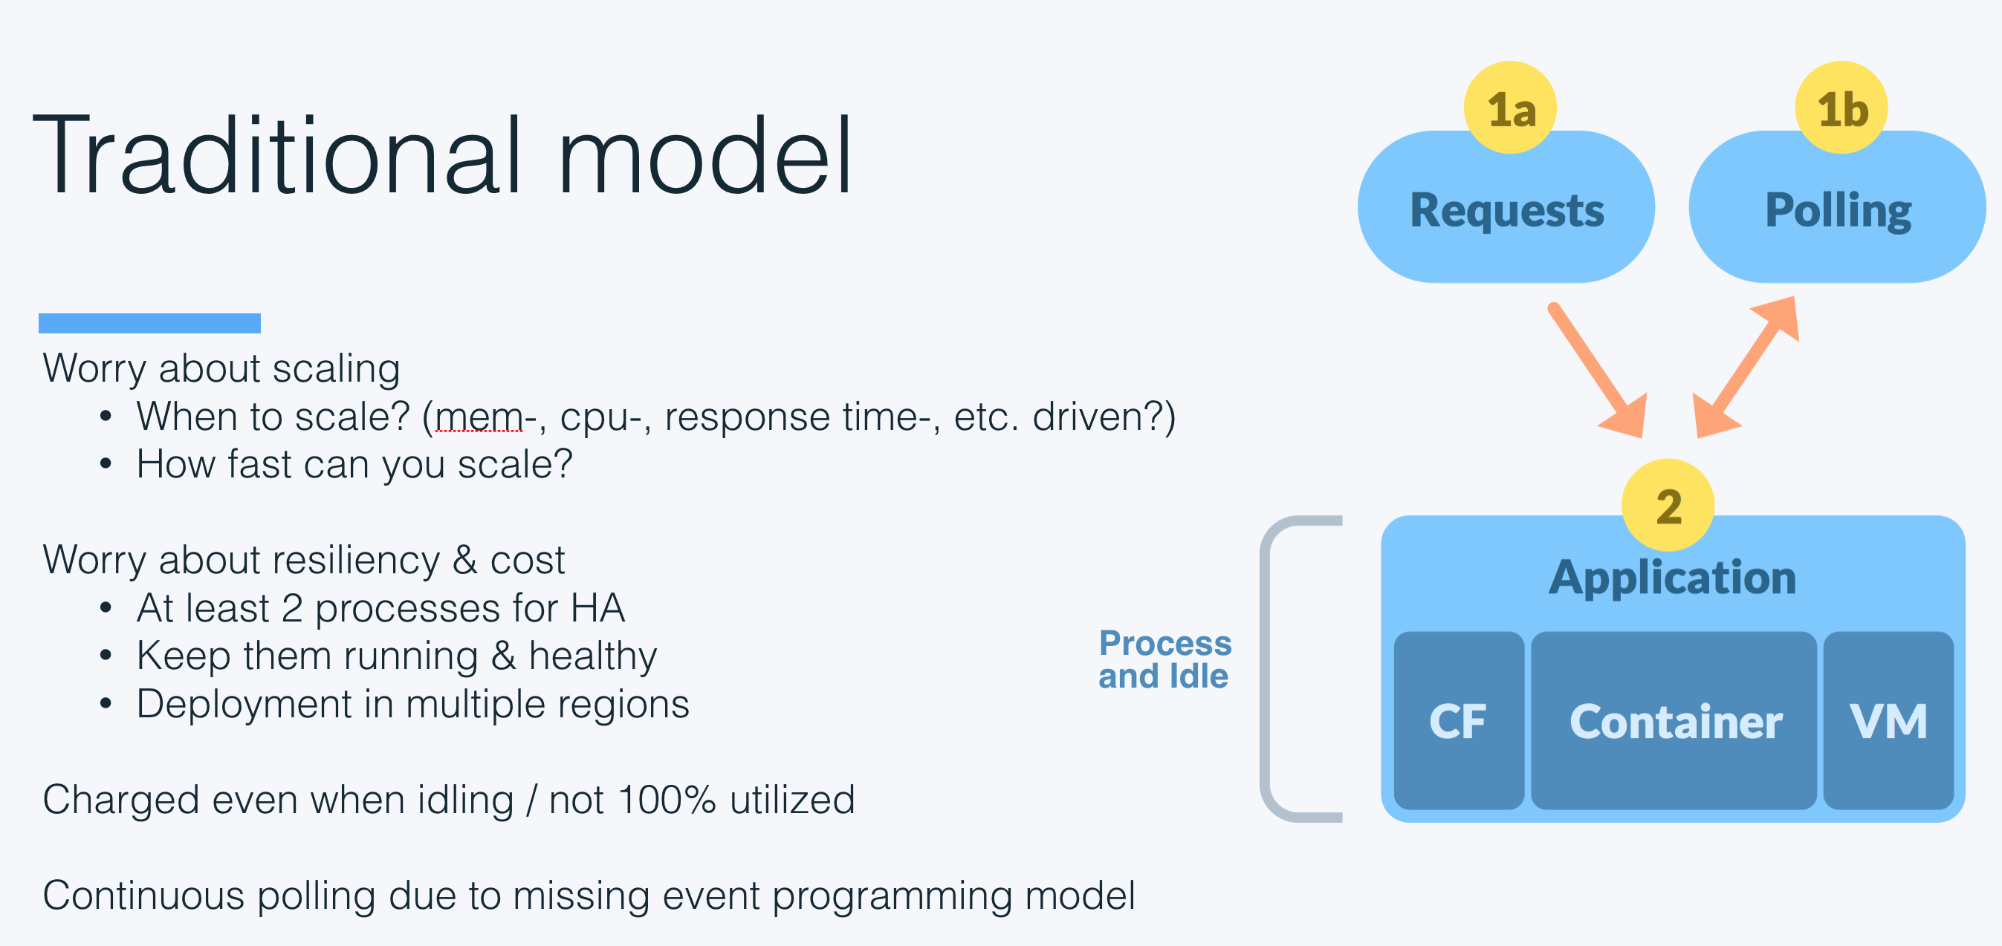

Slide 4
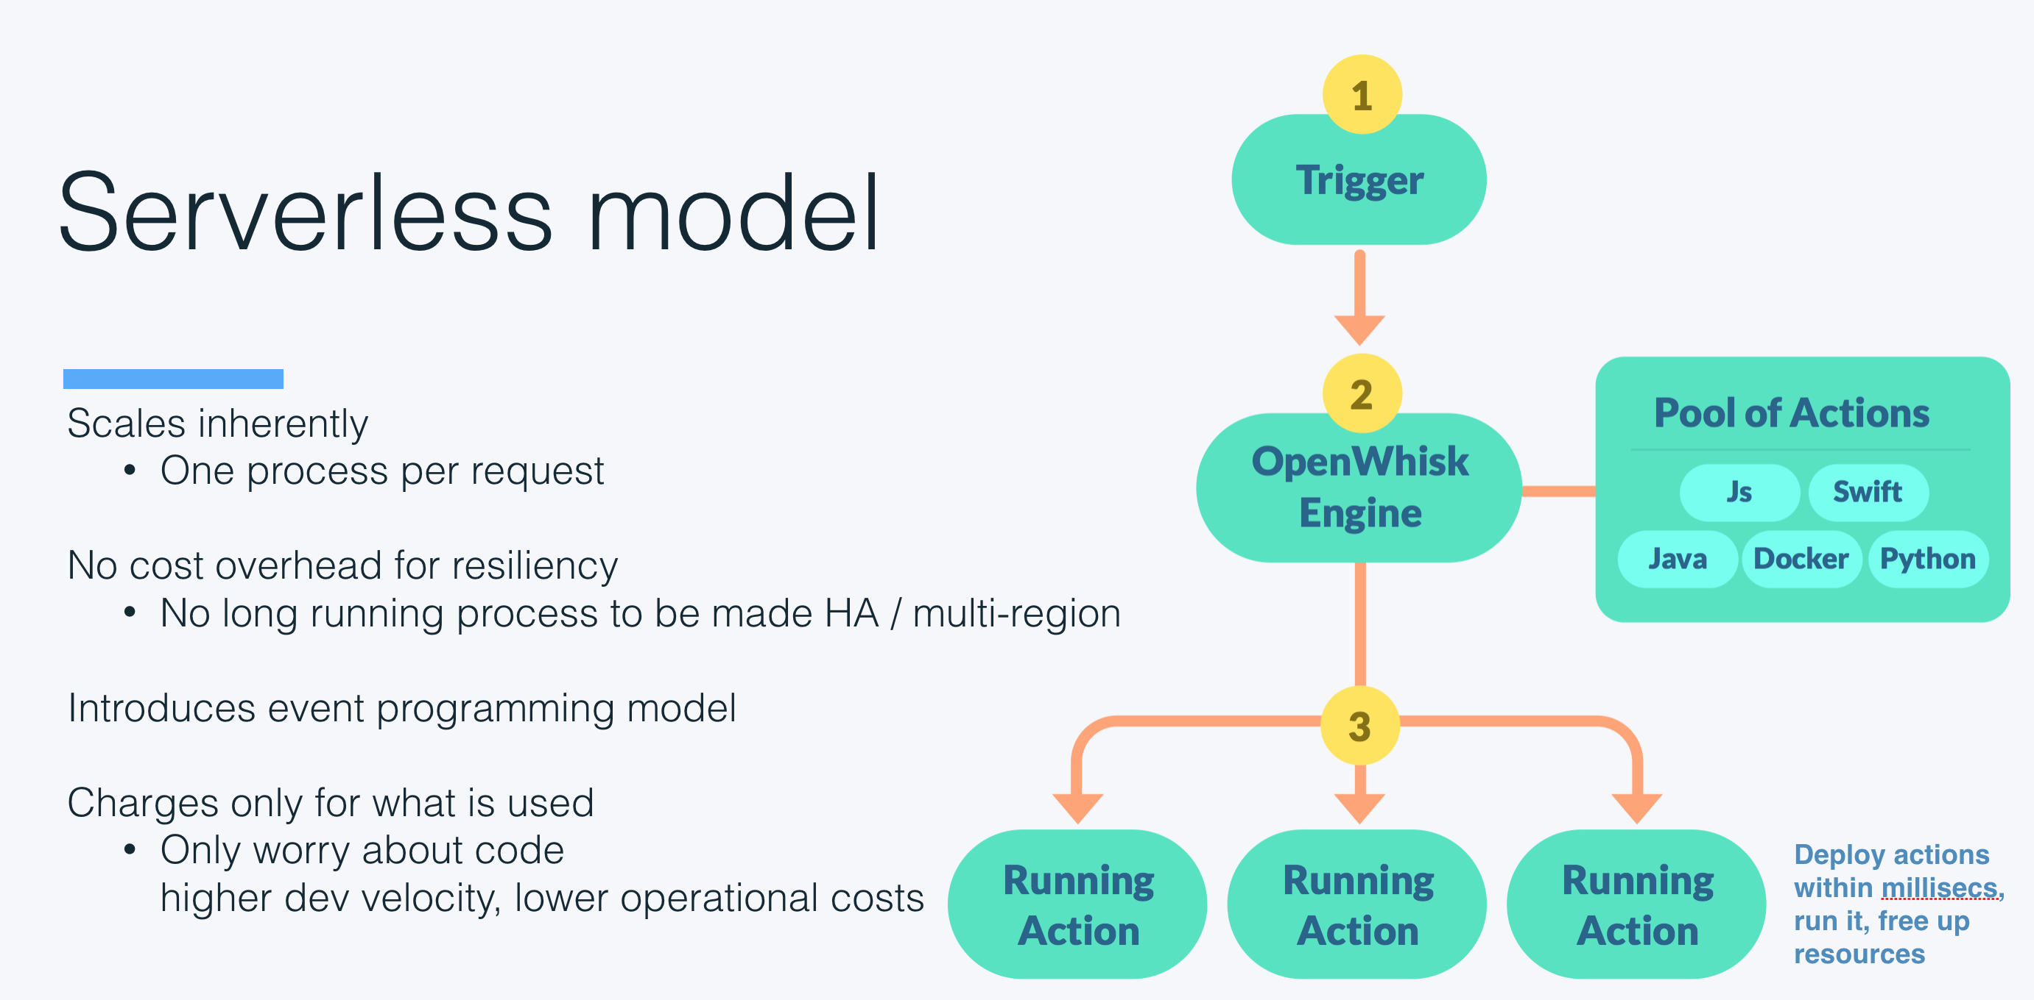

Slide 5

OpenWhisk
FaaS platform to execute code in response to events
Apache open source project:
openwhisk.org

Slide 6
IBM Cloud Functions
FaaS platform to execute code in response to events
IBM Cloud Functions:
Managed service as part of
the IBM Cloud
bluemix.net/openwhisk

Slide 7






IBM Watson and Cloud Platform
Application
Healthcare
Financial
Services
Logistics
DsX
IoT
Virtual agent
AI
Conversation
Discovery
Compare
+ Comply
Knowledge Query
Tone Analysis
Personality
Insights
Visual
Recognition
Speech
Document Conversion
Nat. Language Understanding
Nat. Language Classifier
+ more...
Data
Ingest
Enrich
Store
Analyze
Apply
The Watson Data Platform
Public, Private, Licensed
Cloud
Dev Services
Containers
Messaging
Blockchain
Logging
+ more...
Infrastructure
Storage
Compute
Physical Network
Infrastructure Mgmt
+ more...

Slide 8
IBM Cloud Functions
OpenWhisk
Concepts
Source (events)
Results
Triggers
(response)
Actions
(code)
Rules

Slide 9
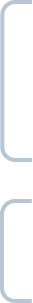
IBM Cloud Functions
JS/NodeJS 6
Swift 3
Multi-
language Support
Java
Docker
Supported Languages
Python 3
PHP
Haskell
Scala
Community
Efforts
…
… and more to come

Slide 10



IBM Cloud Functions
OpenWhisk
Support for different invocation models
Blocking
Non-blocking
Periodic

Slide 11

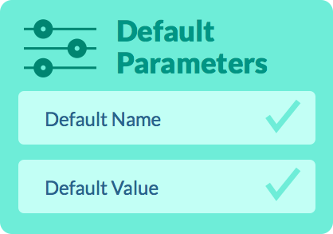
IBM Cloud Functions
OpenWhisk
Supports higher-level programming constructs
Action 1
Action 2
Chaining/
Sequencing
Parameter
Binding
Notes:
Parameter binding allows you to “bind” things like credentials etc. to an action without having to hardcode them directly within your action or specify them on each invocation.
Sequencing allows you to declaratively chain together multiple actions that can then be executed sequentially; it’s like piping in Linux.

Slide 12
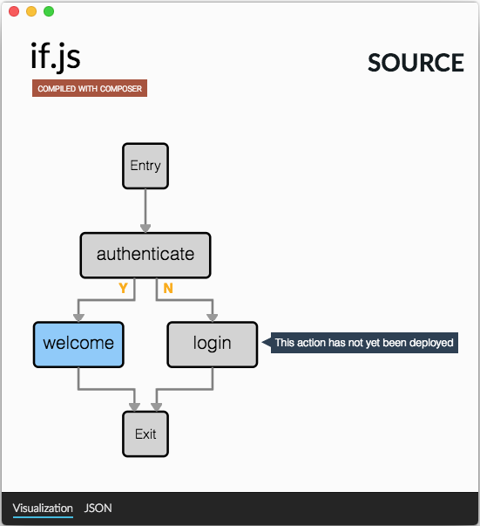
IBM Cloud Functions
OpenWhisk
A Differentiated Model for FaaS Composition
Respond to the need for more complex, coordinated flows required for end to end solutions across cloud Services
Enable more expressive programming through direct integration of new constructs into existing language bindings
Composition, Control Flow and State Management
Notes:
Parameter binding allows you to “bind” things like credentials etc. to an action without having to hardcode them directly within your action or specify them on each invocation.
Sequencing allows you to declaratively chain together multiple actions that can then be executed sequentially; it’s like piping in Linux.

Slide 13





IBM Cloud Functions
OpenWhisk
Event
Provider
Periodic
IBM Cloudant
Message Hub
Mobile Push
Github
IBM App Connect

Slide 14
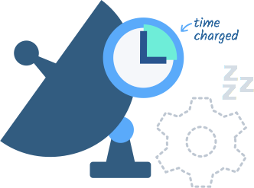
IBM Cloud Functions
OpenWhisk
Granular pricing
Pay only for the exact time your actions run. When an action is not invoked, it’s not in memory, so you don’t pay anything.

Slide 15
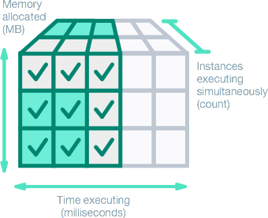
IBM Cloud Functions
OpenWhisk
Reduce Costs
Time an action was running * memory allocated to action $ 0.000017 per GBs
Free tier: 400000 GBs

Slide 16
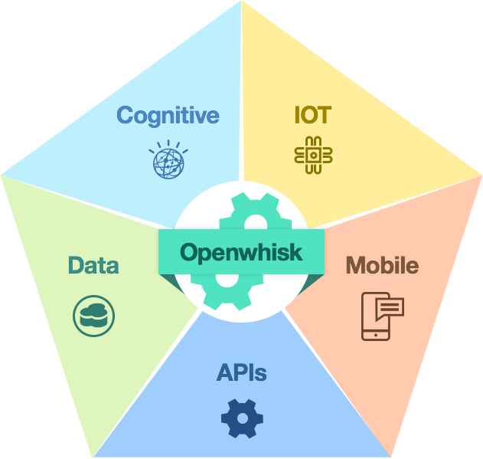
What is serverless good for?
OpenWhisk allows you to build up an entirely serverless application architecture
Notes:
OpenWhisk allows you to build up an entirely serverless application architecture
Today, you already being provided with different (cloud-managed) services falling into totally different domains without being forced to manage servers
OpenWhisk does now additionally provide you with serverless compute power allowing you to run custom application logic in a serverless fashion, too

Slide 17



Customers and Partners
Customers and Partners
Clients
Partners
Notes:
COVERED BY MICHAEL & ME IN DETAIL

Slide 18

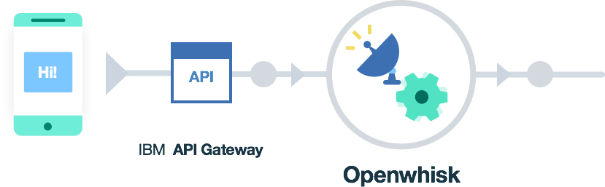

What is IBM Cloud Functions good for?
What is OpenWhisk good for?
Outsource compute-intensive tasks to a powerful & scalable serverless platform and implement your actions even without changing the programming language.
Mobile backend

Slide 19
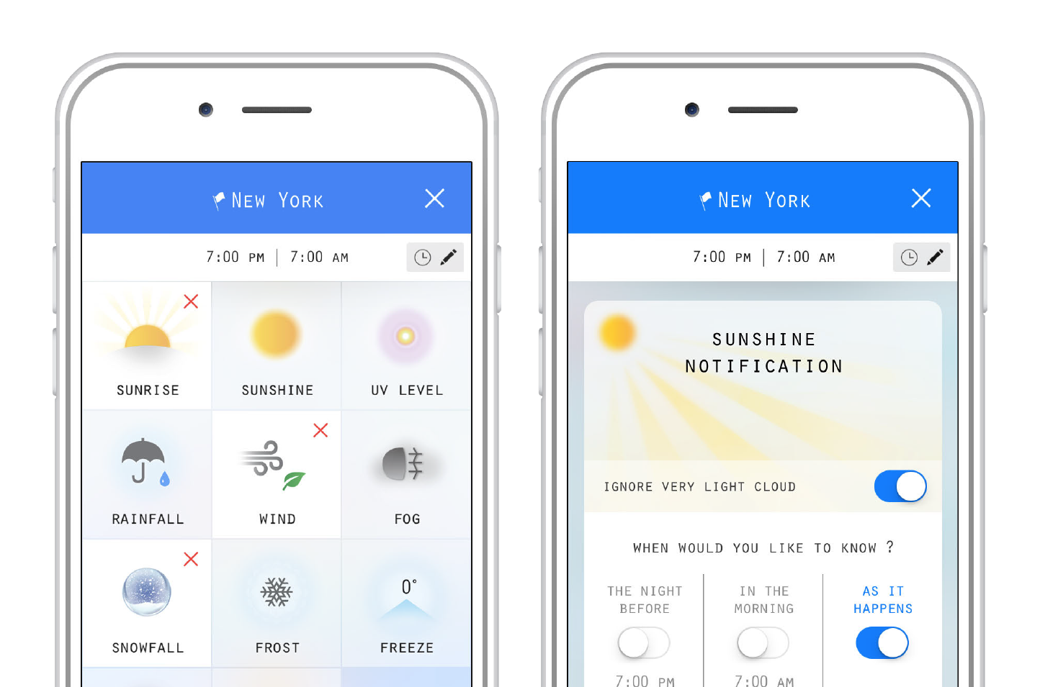

What is IBM Cloud Functions good for?
What is Serverless good for?
What is OpenWhisk good for?
Mobile backend
The Weather Gods
https://itunes.apple.com/us/app/weather-gods/id1041512978?mt=8

Slide 20


The Weather Gods High Level Architecture
Weather Update Trigger
3
Weather Gods
Rain Scanner
OpenWhisk Actions
External
Weather Model
Data
Snow Scanner
Triggers
2
Weather Checker
TWC
Wind Scanner
Bluemix Notification
Cron trigger every 3 minutes
1
Group Scanner
Notification Model
Storm Scanner
Notification
4
Send Notification
Frost Scanner
Weather Collector Trigger
Set flag to check weather for each user location in the group
ETC Scanner
Notification Trigger
For each user location updated
Cloudant

Slide 21

What is IBM Cloud Functions good for?
What is OpenWhisk good for?
Data processing

Slide 22
What is IBM Cloud Functions good for?
What is OpenWhisk good for?
Data processing
Ideally suited for working with multimedia data like audio, image and video data:
Audio normalization
Image rotation, sharpening, noise reduction or
Thumbnail generation
Image OCR’ing
Video transcoding
…

Slide 23
What do our customers do with IBM Cloud Functions?
Data processing
http://ecc.ibm.com/case-study/us-en/ECCF-CDC12387USEN
10x faster 90% less cost

Slide 24

SiteSpirit High Level Architecture
Per Customer
Crop Resolutions Buckets
Sequence
Upload Bucket
1
Object Storage
?
4
Trigger
Action
mediaspirit-newfile-uploaded
ms2-crop-done
mediaspirit-transform
ms2-moveuploaded-done
+
2
+
+
ms2-imagecropper
cloudant/create
ms2-moveuploaded-upload
3
+
+
ms2-fetch-cropres
ms2-get-clientconfig
+
ms2-cloudant-trigger
ms2-get-clientconfig
Costumer DB
ms2-changelistener
ms2-image-moveupload-trigger
ms2-imagecrop -trigger
Manager DB

Slide 25


What do our customers do with IBM Cloud Functions?
Data processing
Less cost <$2 for all paper checks
processed within 1 year

Slide 26


Santander High Level Architecture
Resized Images
Represents System of Records
Archived
Audited
Parsed
Processed
Save Images
Changes
Changes
1
2
3
4
Find Checks
Parse
Check
Record
Deposit
Object Storage
OCR Engine
Email Notification
IBM Bluemix Openwhisk
IBM Cloudant
Trigger
Action

Slide 27
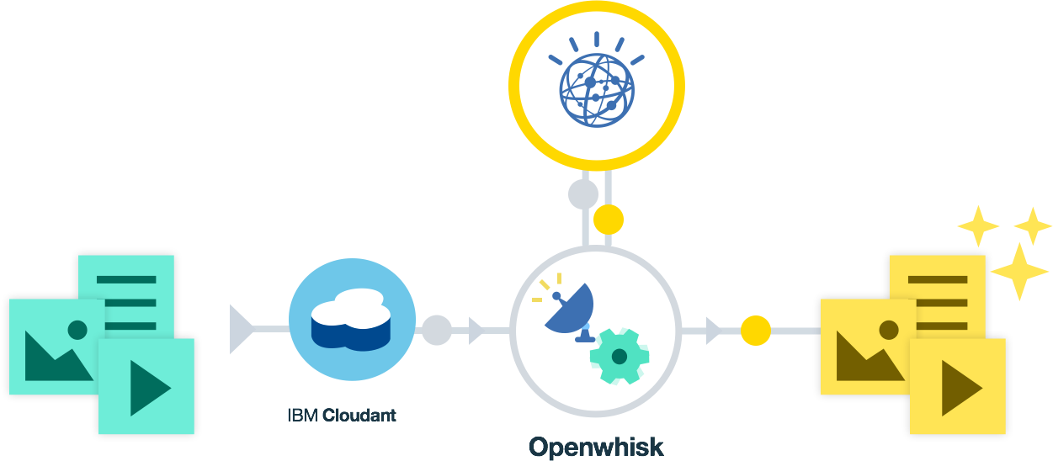
What is IBM Cloud Functions good for?
What is OpenWhisk good for?
Cognitive

Slide 28

What is IBM Cloud Functions good for?
What is OpenWhisk good for?
Cognitive
Skylink
https://github.com/IBM-Bluemix/skylink

Slide 29




What is Serverless good for?
Abilisense
https://www.abilisense.com/

Slide 30
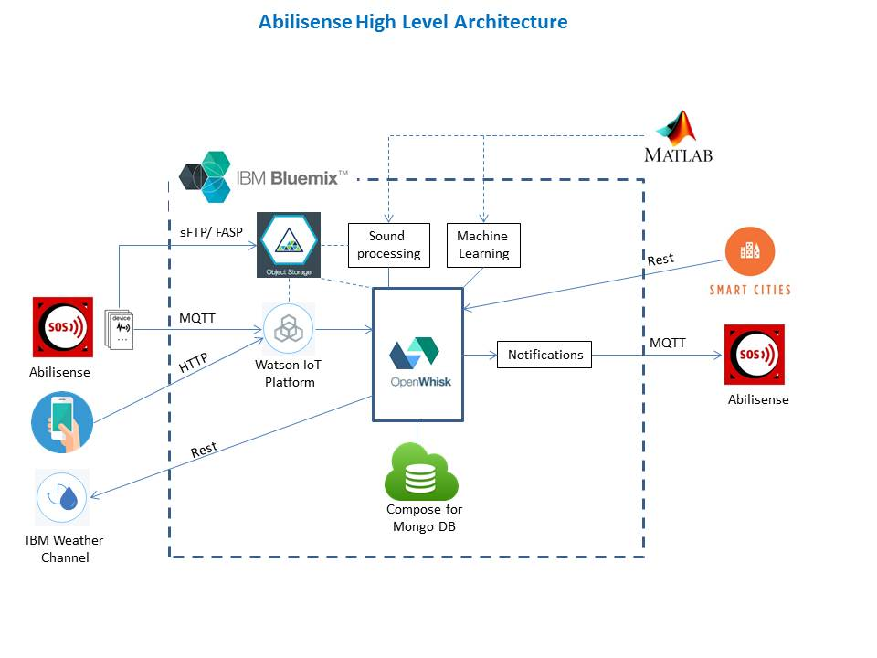



Abilisense High Level Architecture
sFTP/FASP
Sound
Processing
Machine Learning
2a
1
Object Storage
Abilisense
2b
MQTT
3
4
Notifications
MQTT
HTTP
IBM Watson IOT
Platform
Openwhisk
Abilisense
REST
REST
IBM Weather Channel
Smart Cities
Compose for MangoDB

Slide 31
Abilisense
Assumptions
Home Devices | 1.000 | Un.
Avg. Sound File Size | 1 | MB
Avg. Number of Sound Readings | 10 | Monthly
IoT Reading Frequency | 1 | Hourly
IoT Recording Data Size | 2 | KB
Weather Data Reading Frequency | 1 | Hourly
Weather Data Reading Size | 2 | KB
Weather Data Total Capability | 1.41 | MB
Assumptions
Runtime Action per Millisecond | 5
Memory MB | 512
Number of Executions | 5,000,000.00
Monthly Cost | $14.45

Slide 32
Potential research areas
Problem determination for apps with a large number of actions
Latency reduction
Density increase
State handling
Building complex apps
…

Slide 33

Learn more
Learn more
Commercial offering home:
bluemix.net/openwhisk
Open-source offering home:
openwhisk.org
Slack:
slack.openwhisk.org

Slide 34
Learn more
Github github.com/openwhisk
Twitter twitter.com/openwhisk
Medium medium.com/openwhisk
Slideshare slideshare.net/OpenWhisk
Youtube youtube.com/channel/UCbzgShnQk8F43NKsvEYA1SA
Learn more

Slide 35
Thank you

